Slide 1



DataVerse
Africa
Project Title:
Analyzing the Impact of Seasonal Income Fluctuations on Household Financial Stability
in Rural Africa
Internship Presentation
ELMA FORTUNATE PHIRI
&
UMEASIEGBU SHALOM [GRP_20]
Presented By:

Slide 2


01
Problem Statement
Context:
Uganda’s rural economy heavily relies on agriculture, with over 70% of the population engaged in
farming. These farmers face seasonal income variations due to the reliance on crop harvests and
livestock sales, leading to uneven cash flows throughout the year. During non-harvest periods, many
households struggle to meet basic needs, causing financial instability. This cyclical nature of income is
further exacerbated by a lack of tailored financial products, leaving households vulnerable to financial
shocks, such as medical emergencies or school fees.
Issue:
The core issue lies in the absence of inclusive and adaptive financial services that align with the agricultural income cycles of rural farmers. Current financial products are not designed with the seasonal nature of agricultural livelihoods in mind, making them inaccessible or ineffective. Additionally, limited financial literacy and physical distance from formal banking infrastructure worsen the situation. As a result, rural households often resort to informal lending or asset liquidation, which can lead to long-term poverty traps.
Impact:
The financial vulnerability caused by these issues significantly undermines the well-being of rural households. Without reliable access to credit, savings, or insurance, families are unable to invest in productivity-enhancing inputs, smooth consumption during lean seasons, or cope with unexpected expenses. This not only stifles rural economic growth but also perpetuates intergenerational poverty. Moreover, the lack of financial security discourages young people from pursuing agriculture, threatening the sustainability of the rural economy.

Slide 3
02
Project Objectives
Primary Objective
Understand the extent to which seasonal income fluctuations impact household financial stability
Secondary Objective
Analyze coping mechanisms used by households during periods of financial stress.
KPI addressing such a household KPIs, seasonal income data KPIs, expense patterns etc
Assess the role of existing financial tools and products in mitigating these effects.
Design insights to recommend innovative financial solutions tailored for rural households experiencing seasonal income variations.

Slide 4

03
Data Cleaning and Transformation
The datasets used in this project were provided by the stakeholders and contain survey data collected from rural Ugandan communities over a 24-month period. The data was divided into two main datasets: one containing household demographic information, and the other detailing seasonal income data.
To ensure data quality and reliability for analysis, the following steps were undertaken:
Handling Missing Values:
We identified null values across both datasets. In collaboration with the stakeholders, we received specific instructions on how to address these missing entries.
Data Consistency and Error Checks:
The datasets were thoroughly reviewed for inconsistencies. Errors and outliers were corrected or removed based on validation rules and contextual understanding.
Feature Engineering:
New columns were created to facilitate deeper insights
Dataset Integration:
To perform comprehensive analyses, the household demographics dataset was merged with the seasonal income dataset using a left join. This ensured that all households in the demographic data were retained.
MISSION

Slide 5
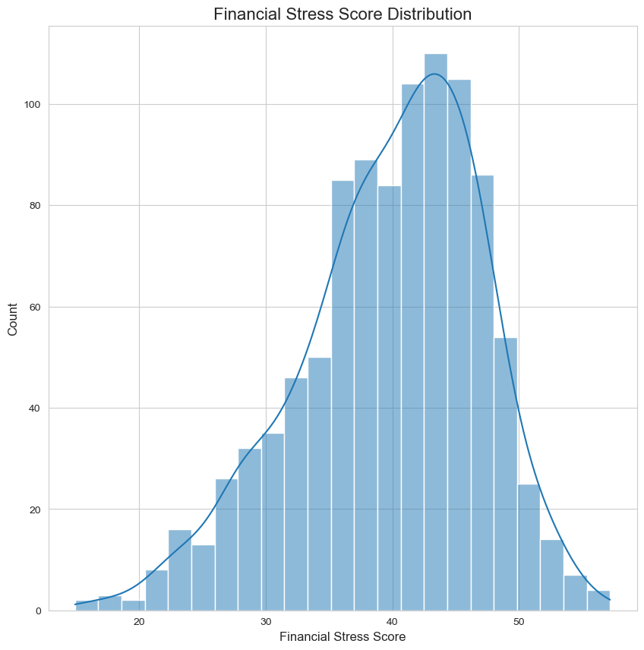
04
Data Insights
The scores for financial stress show a shape that is mostly normal, with an average sitting at about 40, and the central range appearing to fall between 35 and 45. Extreme low or high scores are observed less frequently. Most households fall between 35-40
MISSION

Slide 6
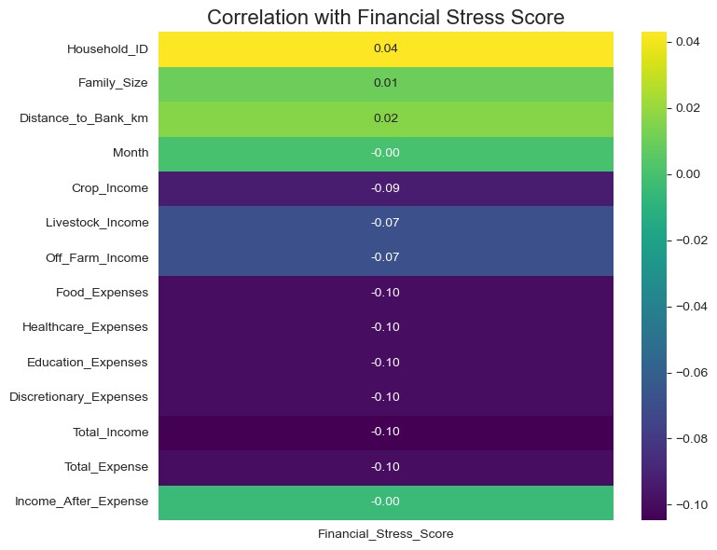
03
Data Insights
This heatmap shows the correlation between various numerical features and the financial stress score. Most features have very weak correlations, with values close to zero, indicating minimal linear relationship. Notably, all income and expense variables have a negative correlation around -0.10, suggesting slightly lower stress with higher income/expenses
MISSION

Slide 7
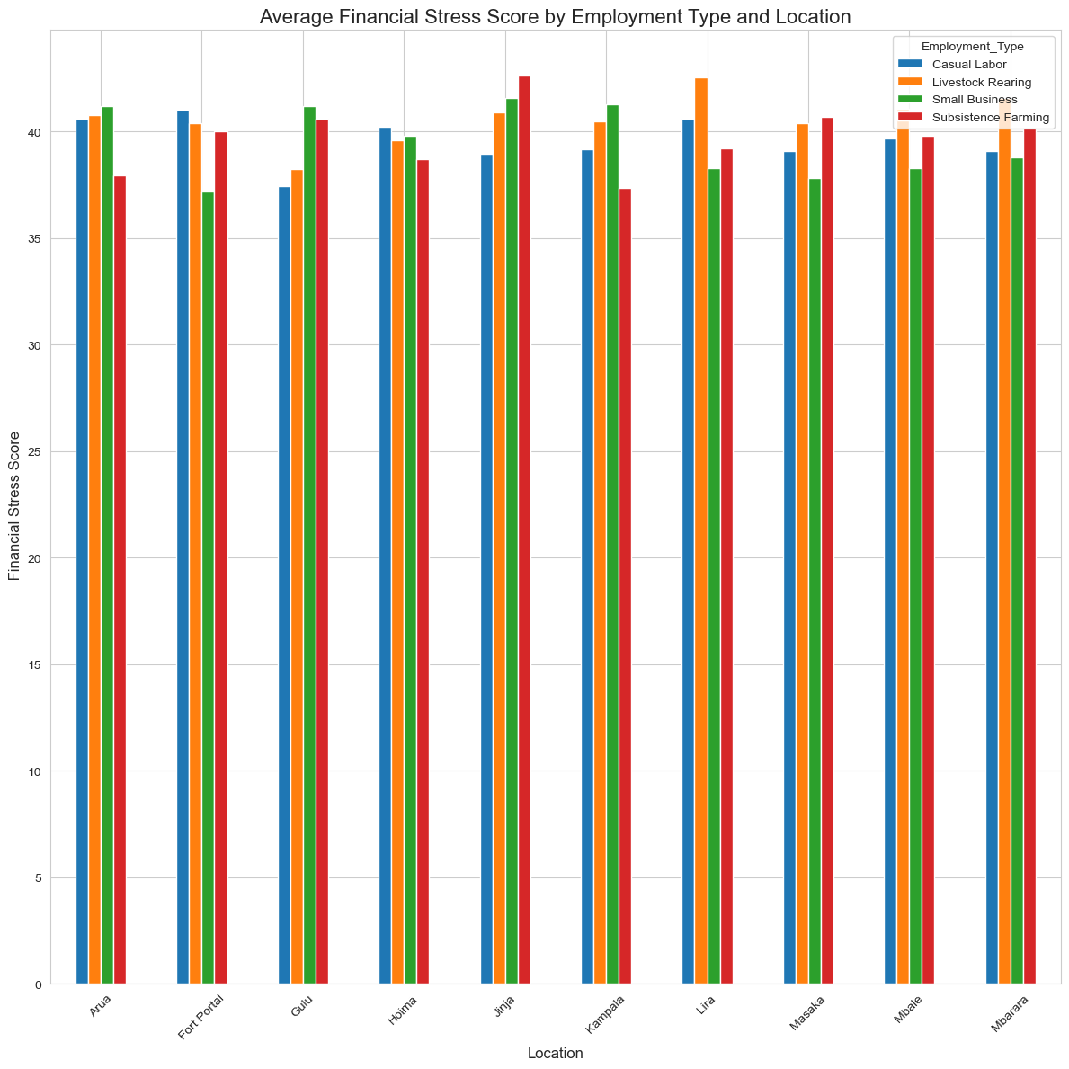
03
Data Insights
The bar chart shows the average financial stress scores across various employment types in Ugandan locations such as Arua, Gulu, Jinja, Kampala, and Masaka. Households engaged in casual labor and livestock rearing generally experience higher stress levels across most locations compared to those in small businesses or subsistence farming. This suggests that irregular income sources contribute more to financial instability, particularly in regions like Jinja and Gulu.
MISSION

Slide 8
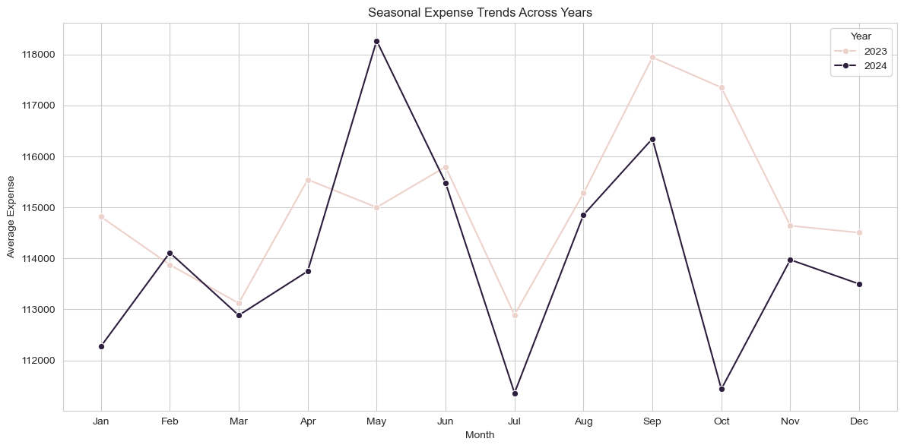
03
Data Insights
Analysis of the expense data indicates a concurrent peak in income and expenditure during May 2024, demonstrating that households adjust their spending proportionally to income fluctuations. Conversely, expenditure reaches its lowest point in July, likely resulting from harvest season conditions when households reduce market purchases while benefiting from their agricultural yields.
MISSION

Slide 9
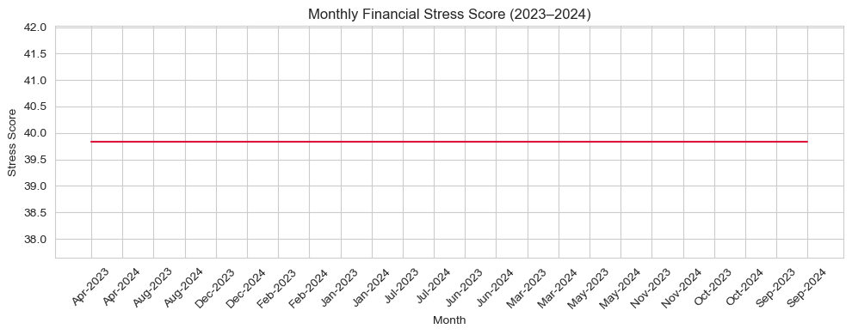
03
Data Insights
The Financial Stress Score remains relatively the same through the months. This suggests that regardless of high/low the expenses/income are, households remain stressed about finances
MISSION

Slide 10
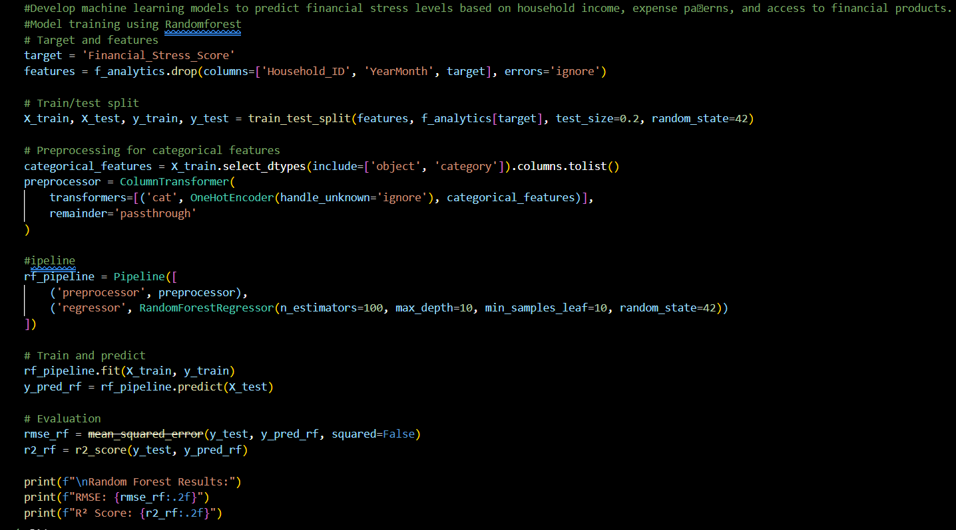
03
Data Insights
We trained our model using RandomForestRegressor and Linear Regression and Gradient Boosting Regressor. Random Forest produced the best-performing model
Random Forest Results:
RMSE: 3.06
R² Score: 0.82
MISSION

Slide 11
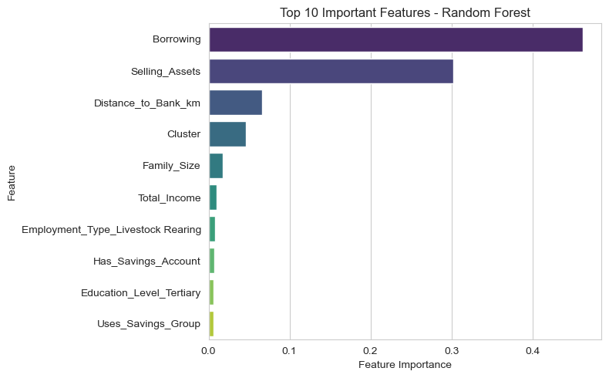
03
Data Insights
This bar chart shows the most important features according to the Random Forest model, which uses many decision trees to make predictions.
The top features are Borrowing, Selling Assets, and Distance to Bank, suggesting financial stress is heavily influenced by how households manage financial emergencies or access services.
MISSION

Slide 12
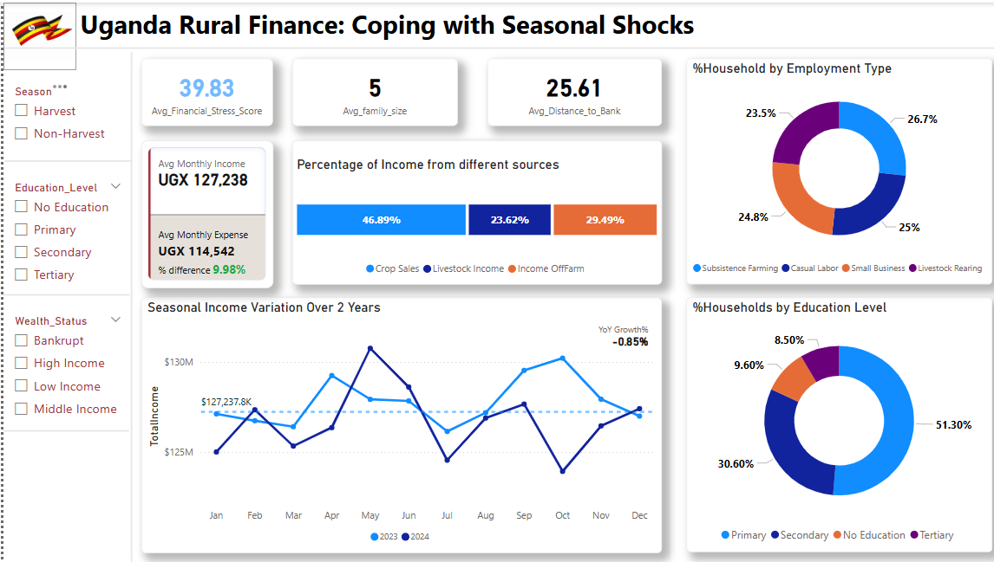
03
Data Insights
MISSION

Slide 13
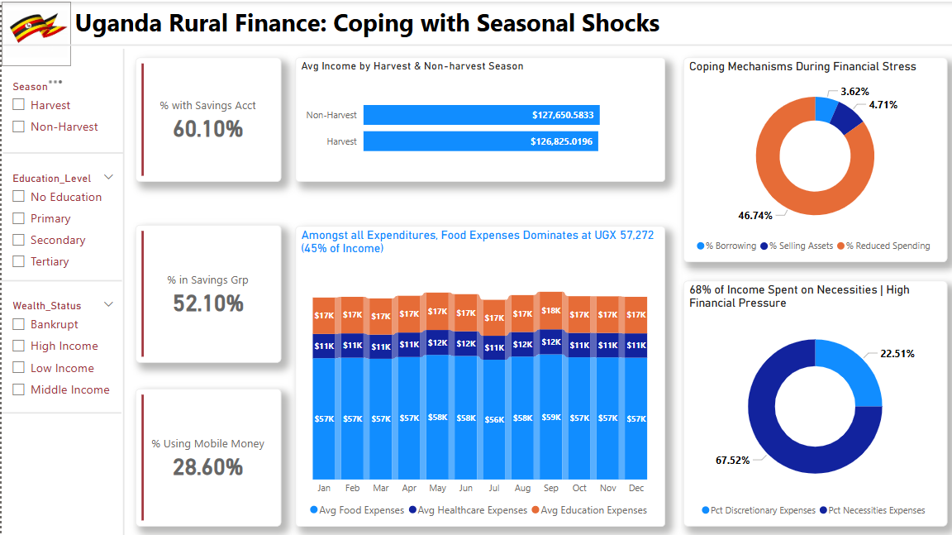
Data Insights
03
MISSION

Slide 14
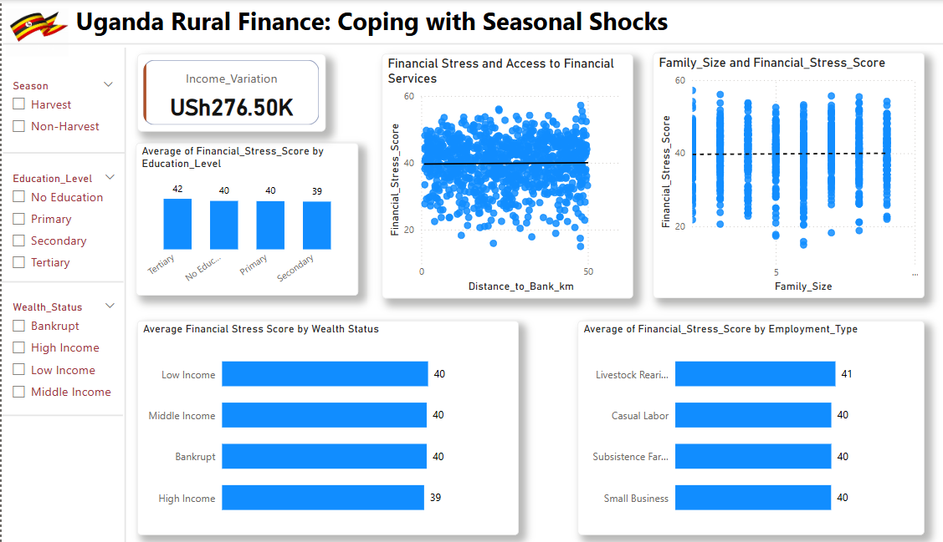
Data Insights
03
MISSION

Slide 15

04
Recommendation
Short-term recommendations
Propose low-interest emergency loans to reduce asset liquidation during crises
Train households in budgeting and emergency fund management.
Address distance barriers (Distance_to_Bank_km) by promoting mobile money services.
Educate individuals about financial literacy
Long-term recommendations
Introduce skills training (e.g., agribusiness, crafts) to reduce dependency on austerity.
Support livestock rearers (Employment Type =Livestock) with veterinary services and market linkages.
Scale up community-based savings circles (Uses_Savings_Group) to improve financial resilience

Slide 16

05
Implementation Plan
Timeline
Short-term(0-6 months)
Identify high-need communities
Collaborate with microfinance institutions (MFIs), credit unions, and mobile banking providers.
Host monthly workshops in accessible locations (schools, markets) for financial literacy
Long-term(12-36 months)
Establish vocational training centers in villages
Establish group savings accounts

Slide 17
05
Implementation Plan
Resources required
Funding
Mobile Banking infrastructure
Trainers
Mobile banking agents
Key stakeholders
Local banks
Community leaders
NGOs

Slide 18
06
Conclusion
This project highlights the pressing need to tackle the financial instability that Uganda's rural households face, especially those that rely on farming. Families often deal with changes in income through harmful measures like borrowing at high interest rates, selling assets or cutting back on essential expenses. By analyzing the situation in clusters, we've identified specific patterns of vulnerability that need different approaches: offering affordable loans during harvest time for those who borrow, providing financial education for those who don't save enough, and encouraging income diversification for families who are cutting back. It’s important to quickly introduce flexible financial options that align with farming cycles, along with making long-term investments in alternative job opportunities and improving access to mobile banking. This could help end the cycle where farmers have a lot of crops but not enough cash. If we connect our efforts with the changing seasons and the unique habits of each household, we can turn subsistence farming into a reliable way to ensure financial stability all year long. This will need teamwork from policymakers, banks, and farming communities to put these focused solutions into action before the upcoming planting season.

Slide 19

DataVerse
Africa
Thank You
Internship Presentation

